Slide 1

Deep Learning
Air Quality and Pollution Index Prediction
khushi chaudhary
U22CS038
V. Deepthi
U22CS083
Date: 12-11-2025
NIT Surat

Slide 2

Air Quality and Pollution Index Prediction
INTRODUCTION of TEAM
Khushi chaudhary: U22CS038
A Btech 4th year CSE Grad. in SVNIT
V. Deepthi
U22CS083
A Btech 4th year CSE Grad. in SVNIT
NIT Surat
Page

Slide 3
INTRODUCTION OF PROJECT
The Challenge of Urban Air Pollution
➔ Increasing Health Risks: NO₂ and other pollutants significantly contribute to respiratory and cardiovascular diseases in cities.
➔ Gaps in Ground Monitoring: Traditional monitoring stations are sparse and costly to maintain — resulting in limited spatial coverage.
➔ Power of Satellite Data: Sentinel-5P provides global, high-resolution measurements of atmospheric pollutants like NO₂.
➔ Need for Data-Driven Insights: Forecasting pollution can help city planners and policymakers take preventive actions.
➔ Bridging the Gap: By combining satellite observations with machine learning, we can predict pollution trends with improved spatial relevance.
NIT Surat
Page

Slide 4
Literature Review(Paper 1)
Blanco et al., 2024 — Urban Air Pollution Forecasting using Satellite Observations and Meteorological Forecasts LINK
Limitations:
Requires multiple datasets (e.g., weather + satellite).
Focused on one city — limited generalization.
High computation cost for large-scale models.
Uses Sentinel-5P NO₂ data + ECMWF forecasts.
Models: Random Forest, Gradient Boosting.
Achieves better prediction accuracy.
Applied to Milan for temporal NO₂ forecasting.
NIT Surat
Page

Slide 5
Literature Review(Paper 2)
Paper 2 — Grzybowski et al., 2023
Ground-Level NO₂ Estimation Using Sentinel-5P & Statistical/ML Methods
Uses Sentinel-5P TROPOMI NO₂ data to estimate ground-level concentrations.
Applies spatial interpolation + ML methods (e.g., Random Forest Regressor, Linear Models).
Demonstrates that satellite NO₂ correlates strongly with ground monitoring stations, improving spatial coverage in data-sparse regions.
Limitations:
Satellite resolution (3.5 km × 5.5 km) introduces spatial averaging errors.
Cloud cover & atmospheric effects reduce retrieval reliability.
Requires ground-station calibration for accurate scaling.
NIT Surat
Page

Slide 6

Gap Analysis
Models tested only on limited cities → poor generalization.
Heavy reliance on ground/met data → not suitable for data-scarce regions.
Sentinel-5P’s coarse resolution & cloud gaps → reduced accuracy.
No real-time or fast-inference prediction pipelines.
Limited visual/diagnostic analysis of NO₂ trends across time.
NIT Surat
Page

Slide 7
Technical Objectives
To preprocess and extract NO₂ data from Sentinel-5P (TROPOMI) for urban air-quality analysis.
To integrate meteorological variables (ECMWF) where required for improved prediction accuracy.
To implement and compare ML models (Random Forest, Gradient Boosting, Linear Models) for NO₂ estimation/forecasting.
To generate spatiotemporal NO₂ visualizations (heatmaps, time-series, distribution plots) using Python/Jupyter.
To evaluate model performance using metrics such as RMSE, MAE, R².
To assess the impact of satellite resolution, cloud cover, and missing data on prediction reliability.
To develop a reproducible NO₂ analysis pipeline combining satellite datasets, ML models, and visualization outputs.
NIT Surat
Page

Slide 8

Our Solution
Pure satellite-driven workflow using Sentinel-5P NO₂ without heavy dependence on ground stations.
Multi-city scalable approach, unlike papers focused on a single region.
Advanced visual analytics (time-series, heatmaps, anomaly detection) built through Jupyter for deeper insights.
Gap-handling techniques to manage missing days, cloud cover, and coarse resolution.
NIT Surat
Page

Slide 9
METHODOLOGY
Data Acquisition
Data Pre-Processing
(cloud filtering, subsetting, gap-filling)
Feature Engineering
(NO₂ extraction, temporal features, scaling)
Evaluation & Visualization
(RMSE/MAE/R² + prediction maps)
Model Development & Training
(RF, GBM, linear models)
Exploratory Data Analysis (EDA)
(heatmaps, trends, anomalies)
NIT Surat
Page

Slide 10
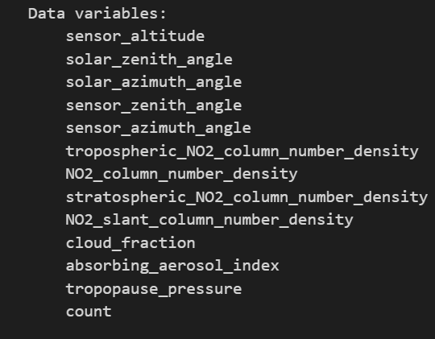
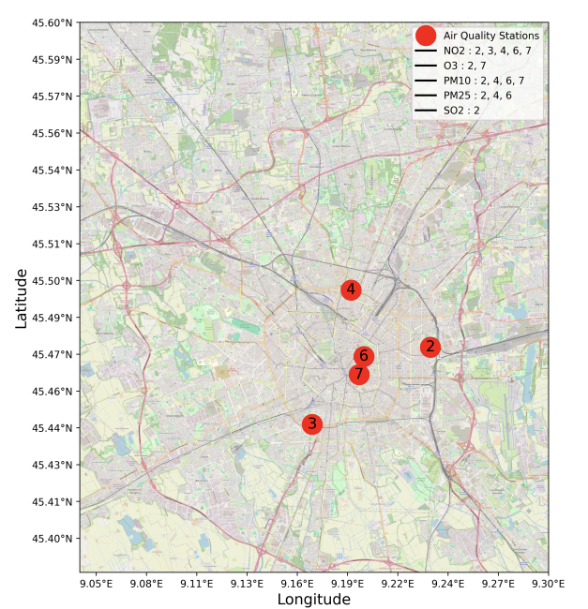
1. Data Acquisition
We collect Sentinel-5P TROPOMI NO₂ satellite data for the study region.
Optional meteorological variables (ECMWF) are used when required.
All datasets are imported and organized in Jupyter Notebook for further processing.
NIT Surat
Page

Slide 11
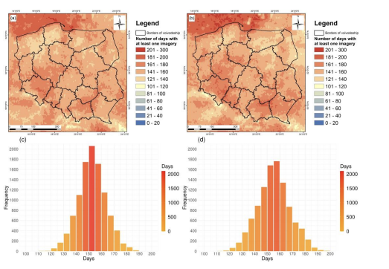
2. Data Pre-Processing
Raw satellite data is cleaned by removing cloud-affected pixels, invalid values, and noise.
The data is spatially cropped to the region of interest and temporally aligned (daily averaging).
Missing days are handled using interpolation or filtering.
before → after
NIT Surat
Page

Slide 12
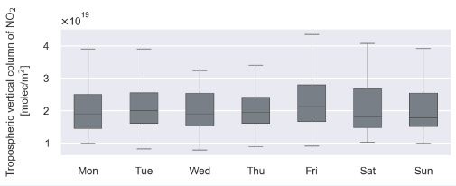
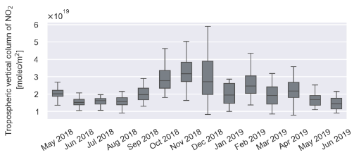
3. Feature Engineering
Key variables such as NO₂ tropospheric column, date components (day, month, season), and optionally meteorological features are extracted.
Features are normalized or scaled to improve machine learning model performance

Slide 13
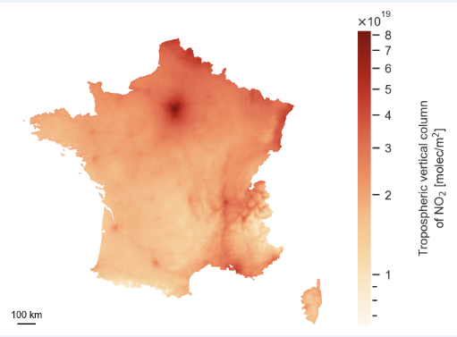
4. Exploratory Data Analysis (EDA)
We generate visual analytics including heatmaps, time-series trends, spatial NO₂ distribution, and anomaly detection to understand pollution behavior.
This step identifies hotspots and seasonal variations.

Slide 14
5. model devlopment andtraning
Model Selection
1.Random Forest Regressor
Handles nonlinear patterns
Robust against noise
2.Gradient Boosting Regressor
Learns patterns iteratively
Very strong for forecasting tasks
3 Linear Regression
Baseline model
Helps compare the improvement
offered by tree-based models
Model Training
Split dataset into Training (80%) and Testing (20%)
Performed k-Fold Cross-Validation to ensure generalization
Hyperparameters Tuned:
✔ n_estimators
✔ max_depth
✔ learning_rate (for Boosting)
✔ min_samples_split, min_samples_leaf
Training done on preprocessed & feature-engineered dataset
Best performing model is selected based on validation score

Slide 15
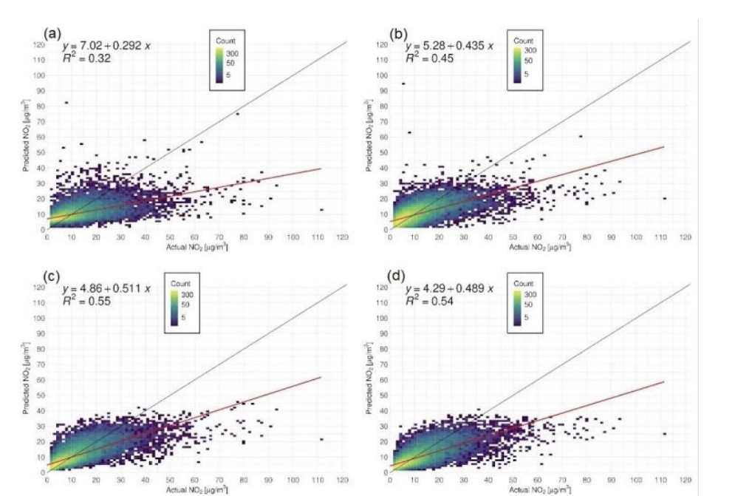
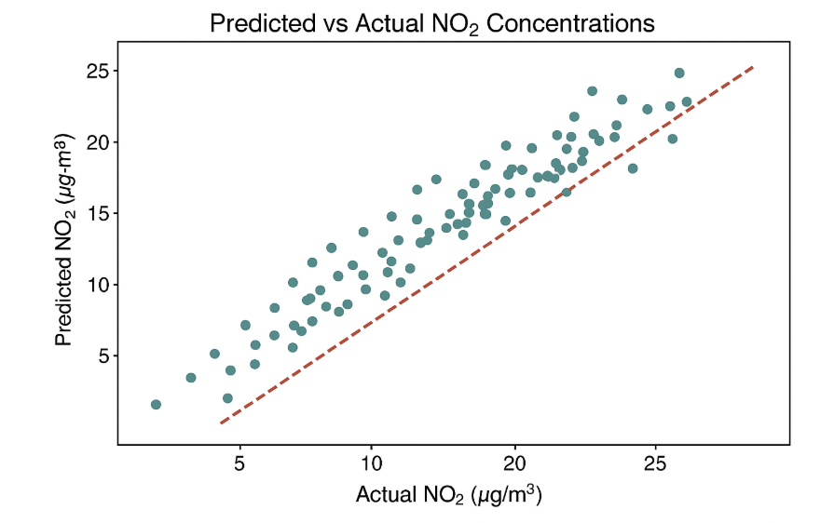
RESULTS AND EVALUTION

Slide 16
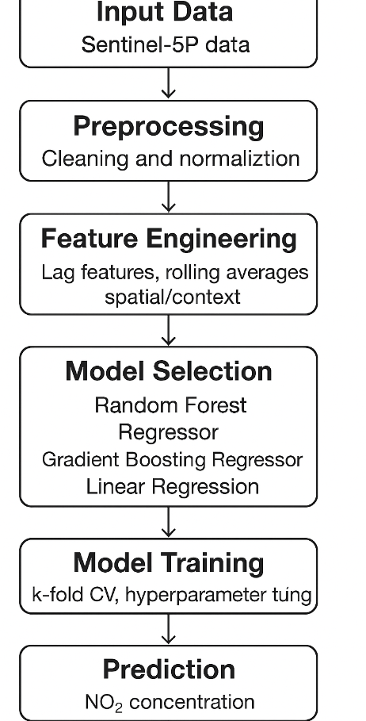

Slide 17


Startup Motivation
• Air pollution monitoring is expensive and limited due to few ground sensors.
• Satellite-based NO₂ estimation provides wider coverage at low cost.
• Cities and industries need accurate air-quality prediction for planning.
• Machine learning helps convert satellite images into useful pollution insights.
• This project can become a scalable solution (app/dashboard/API) for real-time NO₂ monitoring and forecasting.

Slide 18
Startup Motivation
• Air pollution monitoring is expensive and limited due to few ground sensors.
• Satellite-based NO₂ estimation provides wider coverage at low cost.
• Cities and industries need accurate air-quality prediction for planning.
• Machine learning helps convert satellite images into useful pollution insights.
• This project can become a scalable solution (app/dashboard/API) for real-time NO₂ monitoring and forecasting.

Slide 19


